Slide 1


ASA DataFest 2020: COVID-19 Virtual Data Challenge
Data Machine Team:
Jose M Casas, Meria Djirar, Anna Lai & Xiaoxiao Wu

Slide 2


Our Question:
50%
40%
Decrease in activity in Canadian parks
Google's Community Mobility Report for Canada found that activity in Canadian parks was down nearly 40 per cent from baseline levels by the end of March.
Increase in internet usage
Rogers Communications Inc. stated that home internet usage is up more than 50 per cent
1) How did the search pattern for indoor vs outdoor activities change in the Canadian population?
2) Is the search of activities related to the number of cases?

Slide 3
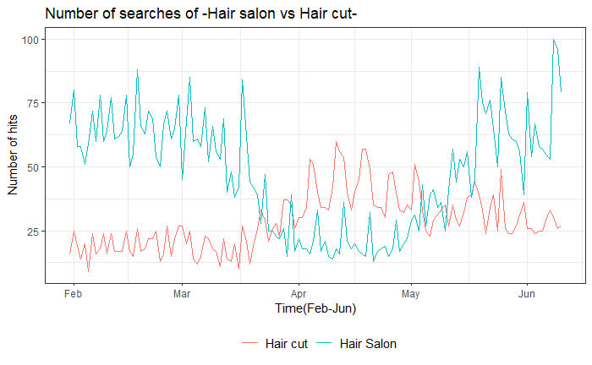
Analysis:
Comparing search terms of:
“Hair Salon” vs “Hair Cut”:
we can see a greater peak for “Hair Cut” search indicator in the periods of April to May corresponding to the quarantine period
“Bake” vs “Bakery”:
Nunavut had the highest indicator of searching “Bake”
British Columbia had the highest indicator of searching “Bakery”

Slide 4
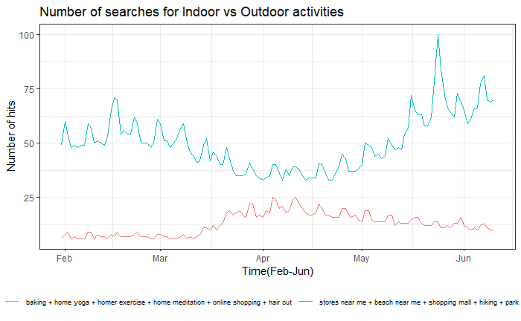
 | Indoor Activities | Outdoor Activities | Average number of cases
Before lockdown (Jan 31th –March 17th ) | Average search hits = 13.90 | Average search hits =43.41 | Mean= 590.44
 | r = 0.84 | r = - 0.77
 | Regression equation: y= 0.008246(x) + 9.11280 | Regression equation: y= -0.0108(x) + 49.81109
 | P-value:3.439x 10⁻¹⁵ | P-value: 8.96 x 10⁻¹²
 | R²=69% | R²=59%
After lockdown (March 18th –June.9th ) | Average search hits = 15.90 | Average search hits =48.7 | Mean= 1145.39
 | r = 0.37 | r = - 0.33
 | Regression equation: y= 45.36(x) + 424.01 | Regression equation: y= -10.44(x) + 1653.59
 | P-value: 0.0005374 | P-value: 0.0018
 | R²= 13% | R²=10%
Findings:
Linear relationship exists between the number of daily new cases and activities during both periods
Covid-19 has negative effects on outdoor search hits
Overall search hits increase during the lockdown period

